Slide 1
Java Programming, 9e Chapter 8
Arrays

Slide 2
Objectives
Declare an array
Initialize an array
Use variable subscripts with an array
Declare and use arrays of objects
Search an array and use parallel arrays
Pass arrays to and return arrays from methods

Slide 3
Declaring an Array (1 of 4)
Array
A named list of data items called elements
All data items have the same type
Declare an array variable
The same way as declaring any simple variable
Insert a pair of square brackets after the type
double[] salesFigure;
int[] idNums;

Slide 4
Declaring Arrays (2 of 4)
Still need to reserve memory space
sale = new double[20];
double[] sale = new double[20];
Subscript
An integer contained within square brackets
Indicates one of the array’s variables or elements
A subscript that is too small or too large for an array is out of bounds
An error message is generated

Slide 5
Declaring Arrays (3 of 4)
An array’s elements are numbered beginning with 0
You can legally use any subscript from 0 through 19 when working with an array that has 20 elements
When working with any individual array element, treat it no differently than a single variable of the same type
Example: sale[0] = 2100.00;

Slide 6
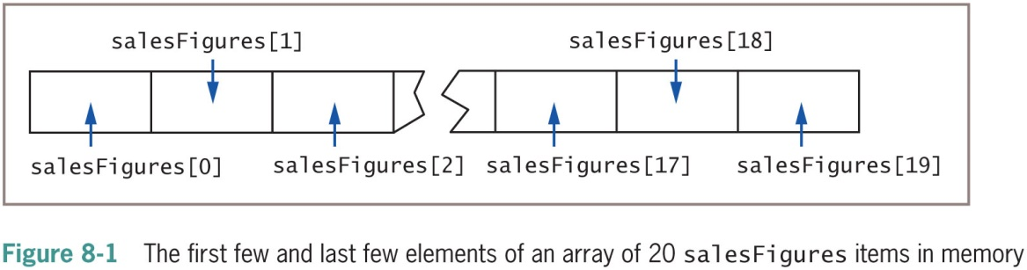
Declaring Arrays (4 of 4)

Slide 7
Initializing an Array (1 of 3)
A variable with a reference type, such as an array, holds a memory address where a value is stored
Array names:
Represent computer memory addresses
Contain references
When you declare an array name:
No computer memory address is assigned
The array has the special value null
Unicode value ‘\u0000’

Slide 8
Initializing an Array (2 of 3)
Use the keyword new to define an array
The array name acquires the actual memory address value
int[] someNums = new int[10];
Each element of someNums has a value of 0
char array elements
Assigned ‘\u0000’
boolean array elements
Automatically assigned the value false
Strings and arrays of objects
Assigned null by default

Slide 9
Initializing an Array (3 of 3)
Assign nondefault values to array elements upon creation
int[] tenMult = {10, 20, 30, 40, 50, 60};
An initialization list initializes an array
Values are separated by commas and enclosed within curly braces
Populating an array
Providing values for all the elements in an array

Slide 10
Using Variable Subscripts with an Array (1 of 4)
Power of arrays
Use subscripts that are variables rather than constant subscripts
Use a loop to perform array operations
for (sub = 0; sub < 5; ++sub)
scoreArray[sub] += 3;

Slide 11
Using Variable Subscripts with an Array (2 of 4)
When an application contains an array:
Use every element of the array in some task
Perform loops that vary the loop control variable
Start at 0
End at one less than the size of the array
It is convenient to declare a symbolic constant equal to the size of the array
final int NUMBER_OF_SCORES = 5;

Slide 12
Using Variable Subscripts with an Array (3 of 4)
Field
An instance variable
Automatically assigned a value for every array created
length field: number of elements in the array
for(sub = 0; sub < scoreArray.length; ++sub)
scoreArray[sub] += 3;
length is a property of the object
Is a field
Cannot be used as an array method

Slide 13
Using Variable Subscripts with an Array (4 of 4)
Enhanced for loop
Allows you to cycle through an array without specifying starting and ending points for the loop control variable
for(int val : scoreArray)
System.out.println(val);

Slide 14
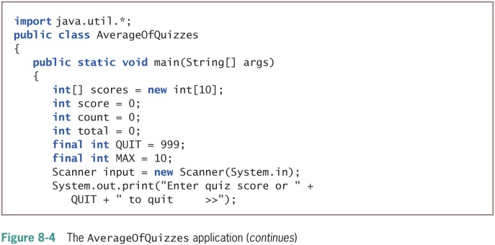
Using Part of an Array (1 of 2)

Slide 15
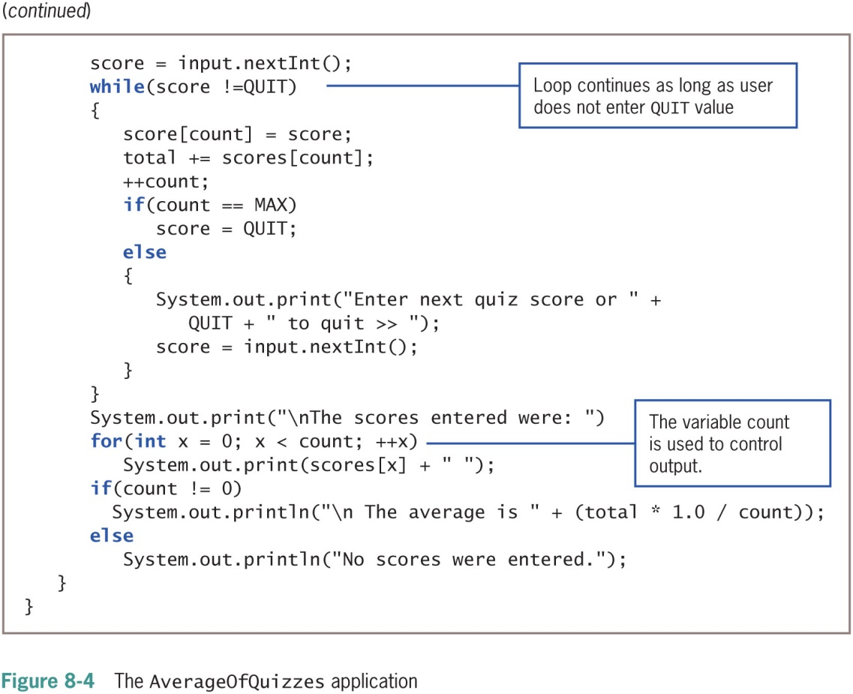
Using Part of an Array (2 of 2)

Slide 16
Declaring and Using Arrays of Objects
Create an array of Employee objects
Employee[] emp = new Employee[7];
Must call seven individual constructors
final int START_NUM = 101;
final double STARTING_SALARY = 15_000;
for(int x = 0; x < emps.length; ++x)
emps[x] = new Employee(START_NUM + x, STARTING_SALARY);

Slide 17
Using the Enhanced for Loop with Objects
Use the enhanced for loop to cycle through an array of objects
Eliminates the need to use a limiting value
Eliminates the need for a subscript following each element
for(Employee worker : emps)
System.out.println(worker.getEmpNum() + " " + worker.getSalary();

Slide 18
Manipulating Arrays of Strings
Create an array of Strings
String[] deptNames = {"Accounting", "Human Resources", "Sales"};
for(int a = 0; a < deptNames.length; ++a)
System.out.println(deptNames[a]);

Slide 19
Searching an Array and Using Parallel Arrays (1 of 2)
Determine whether a variable holds one of many valid values
Use a series of if statements
Compare the variable to a series of valid values

Slide 20
Searching an Array and Using Parallel Arrays (2 of 2)
Searching an array
Compare the variable to a list of values in an array
for(int x = 0; x < validValues.length; ++x)
{
if(itemOrdered == validValues[x])
isValidItem = true;
}

Slide 21
Using Parallel Arrays (1 of 3)
Parallel array
One with the same number of elements as another
The values in corresponding elements are related
An alternative for searching
Use the while loop

Slide 22
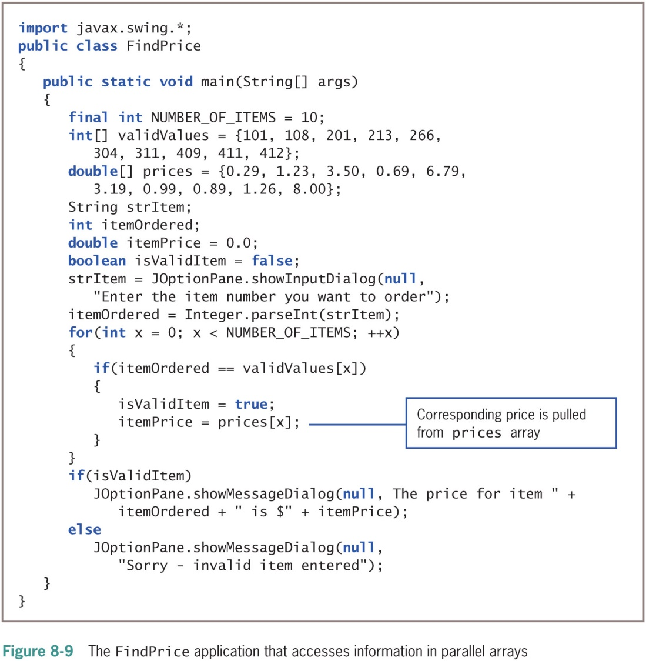
Using Parallel Arrays (2 of 3)

Slide 23
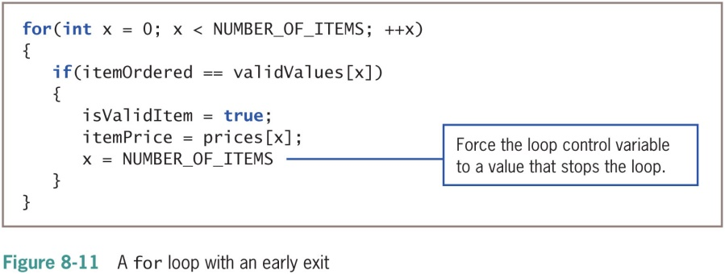
Using Parallel Arrays (3 of 3)

Slide 24
Searching an Array for a Range Match (1 of 2)
Searching an array for an exact match is not always practical
Range match
Compare a value to the endpoints of numerical ranges
Find the category in which a value belongs

Slide 25
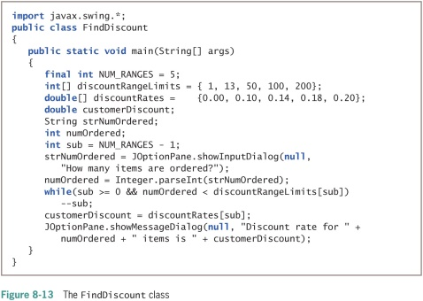
Searching an Array for a Range Match (2 of 2)

Slide 26
Passing Arrays to and Returning Arrays from Methods (1 of 4)
Pass a single array element to a method
Same as passing a variable
Passed by value
A copy of the value is made and used in the receiving method
All primitive types are passed this way

Slide 27
Passing Arrays to and Returning Arrays from Methods (2 of 4)
Reference types
The object holds a memory address where the values are stored
The receiving method gets a copy of the array’s actual memory address
The receiving method has the ability to alter the original values in the array elements

Slide 28
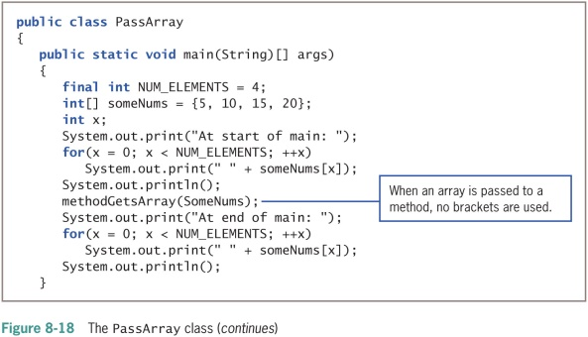
Passing Arrays to and Returning Arrays from Methods (3 of 4)

Slide 29
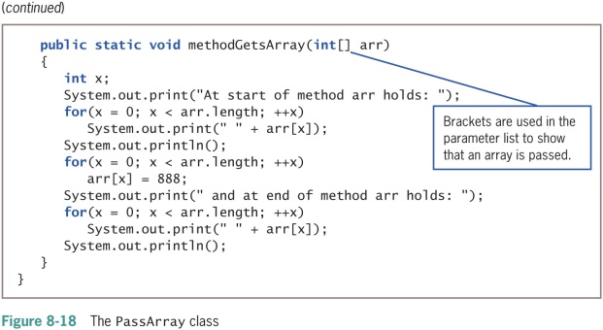
Passing Arrays to and Returning Arrays from Methods (4 of 4)

Slide 30
Returning an Array from a Method
A method can return an array reference
Include square brackets with the return type in the method header

Slide 31
Don’t Do It
Don’t forget that the lowest array subscript is 0
Don’t forget that the highest array subscript is one less than the length
Don’t forget the semicolon following the closing curly brace in an array initialization list
Don’t forget that length is an array property and not a method
Don’t place a subscript after an object’s field or method name when accessing an array of objects
Don’t assume that an array of characters is a string
Don’t forget that array names are references
Don’t use brackets with an array name when you pass it to a method

Slide 32
Summary (1 of 2)
Array
A named list of data items
All have the same type
Array names
Represent computer memory addresses
Shorten many array-based tasks
Use a variable as a subscript
length field
Contains the number of elements in an array

Slide 33
Summary (2 of 2)
You can declare arrays that hold elements of any type, including Strings and other objects
Search an array to find a match to a value
Perform a range match
Pass a single array element to a method

